Slide 1
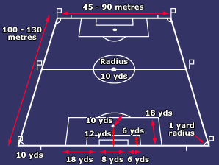
This is the official diagram showing the dimensions of a football pitch.
What is strange about it?
Find the area of the 18-yard box (including the extra segment).

Slide 2
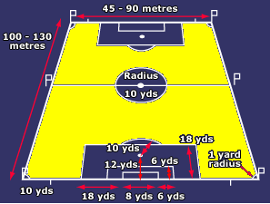
I want to know the percentage of the pitch that is coloured yellow.
What are the upper and lower bounds of this percentage?

